Slide 1

Social Media Analytics for Paradigm Music
Notes:
This presentation introduces how Paradigm Music can use social media analytics to understand what songs and playlists resonate most with listeners. By turning shared activity into visual insights, the company can connect music trends to audience behavior, identify emerging interests, and make decisions that strengthen engagement and growth.

Slide 2

Mission and Plan
Mission: help users share playlists and find nearby favorites
Goal: learn what is popular across places and groups
Plan: goals to metrics, visuals that tell the story, next steps
Notes:
Paradigm Music’s mission is to make music sharing and discovery simple and social. The goal is to understand what songs and playlists are trending across different locations and audiences. This plan connects our goals to clear metrics and visual storytelling that show progress and guide the next steps for growth.

Slide 3
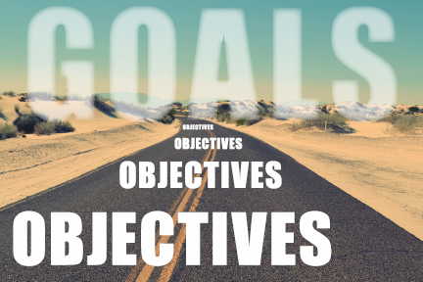
From Goals to Measurable Objectives
Grow monthly active users
Increase shares and saves
Lift conversion to account sign up
Notes:
This slide shows how Paradigm Music can turn broad goals into measurable actions. We focus on growing monthly active users, boosting playlist shares and saves, and improving conversion rates for new sign-ups. Each objective ties directly to user engagement and helps translate ideas into trackable business results.

Slide 4

Key Performance Indicators
Conversion rate: sign ups and saves
Engagement: CTR and average session time
Bounce and return rate
Share rate and referral traffic
Mobile performance and search ranking
Notes:
These KPIs link user behavior directly to business outcomes. We focus on sign-up and save rates to measure growth, track engagement through click-throughs and session time, and monitor bounce and return rates to gauge interest. Strong mobile performance and search visibility help protect reach and keep the platform competitive.

Slide 5
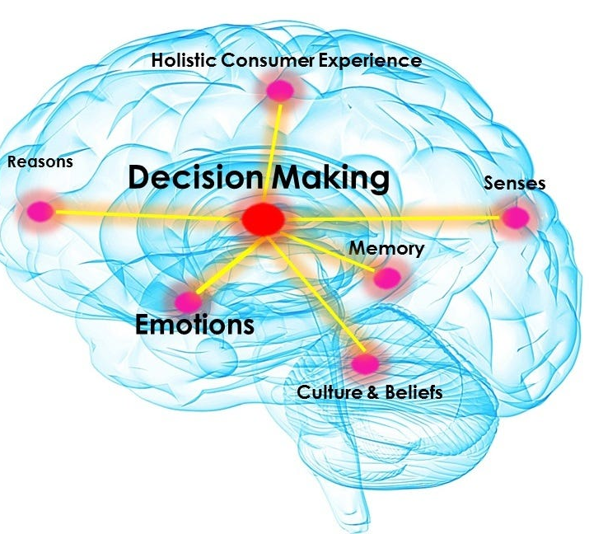
How Visualization Guides Decisions
Dashboards show change over time
Heat maps show where interest clusters
Segment charts explain who engages
Sentiment views show how people feel
Notes:
Visualizations turn complex data into clear stories that drive action. Line charts highlight rises or dips in engagement, heat maps show where interest is strongest, and segment charts reveal which age or gender groups respond most. Sentiment views then capture how people feel about top songs, helping guide creative and marketing choices.

Slide 6


What Successful Firms Do
Interactive dashboards for weekly reviews
Automated reports to owners
AB tests on wording and button place
Influencer impact tracking
Notes:
Leading firms stay proactive by using live dashboards that track product and marketing performance in real time. They automate weekly summaries for quick decision-making, run A/B tests to fine-tune content and design, and monitor influencer campaigns to see how creator posts drive engagement and conversions.

Slide 7
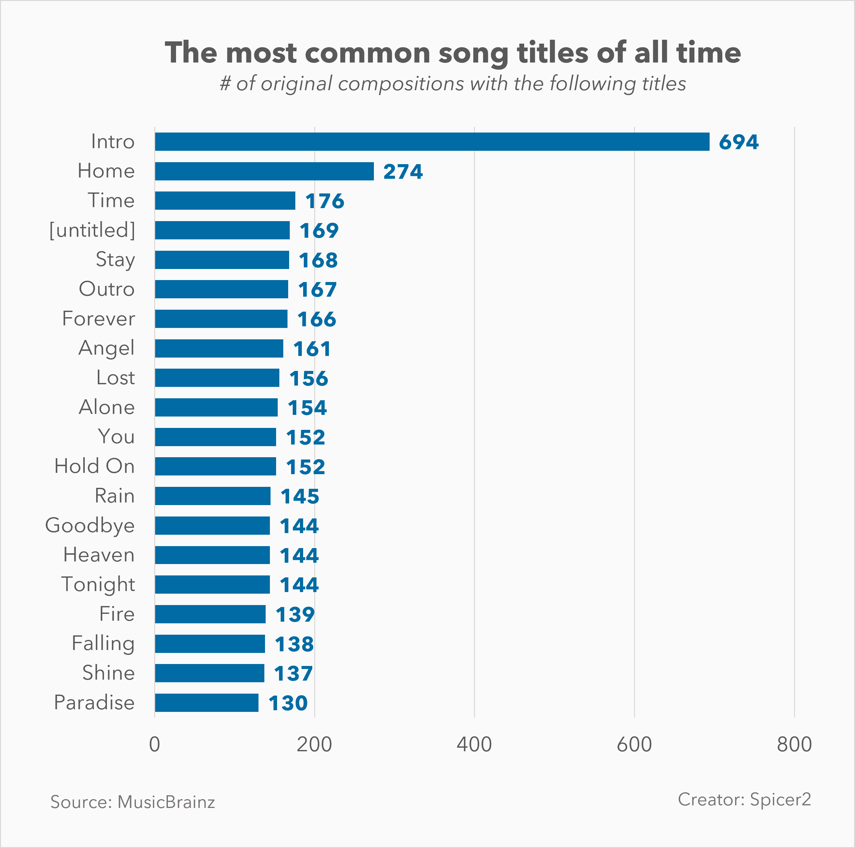
Insights from Shared Song Titles
Top songs and genres by city and campus
Time of day and day of week patterns
Creator effect on spread
Paths from view to save to share
Notes:
Shared song titles reveal powerful patterns in listening behavior. By mapping titles to cities and schools, we can see how certain songs trend by region or community. Time-based data highlights daily and weekly peaks, while creator analysis shows who drives the biggest waves of engagement. Tracking the journey from a view to a save and then to a share uncovers what truly makes a song spread.

Slide 8
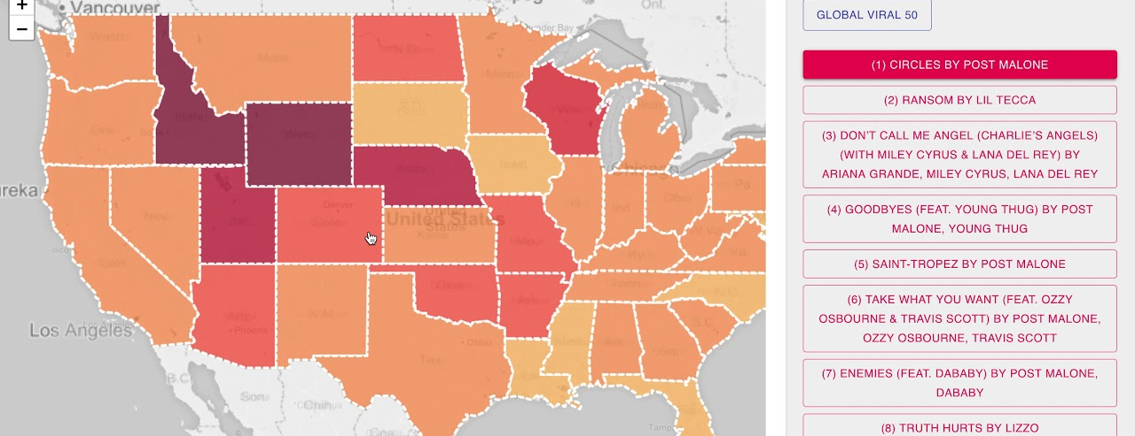
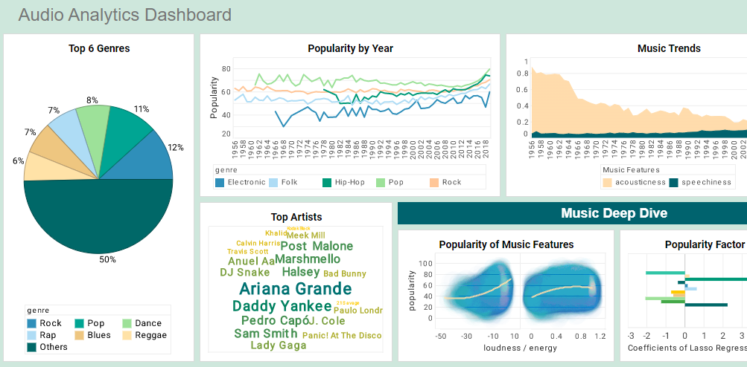
Visualization Methods
Charts and graphs for trends
Heat maps for geography
Word clouds for top mentions
Dashboards for real time review
Notes:
Each visualization type serves a clear purpose. Line charts track movement over time, bar charts compare performance across groups, and pie charts summarize smaller sets like top genres. Heat maps highlight regional trends, and word clouds make popular song titles stand out instantly. Combining these visuals into a single dashboard keeps teams aligned with real-time insights.

Slide 9
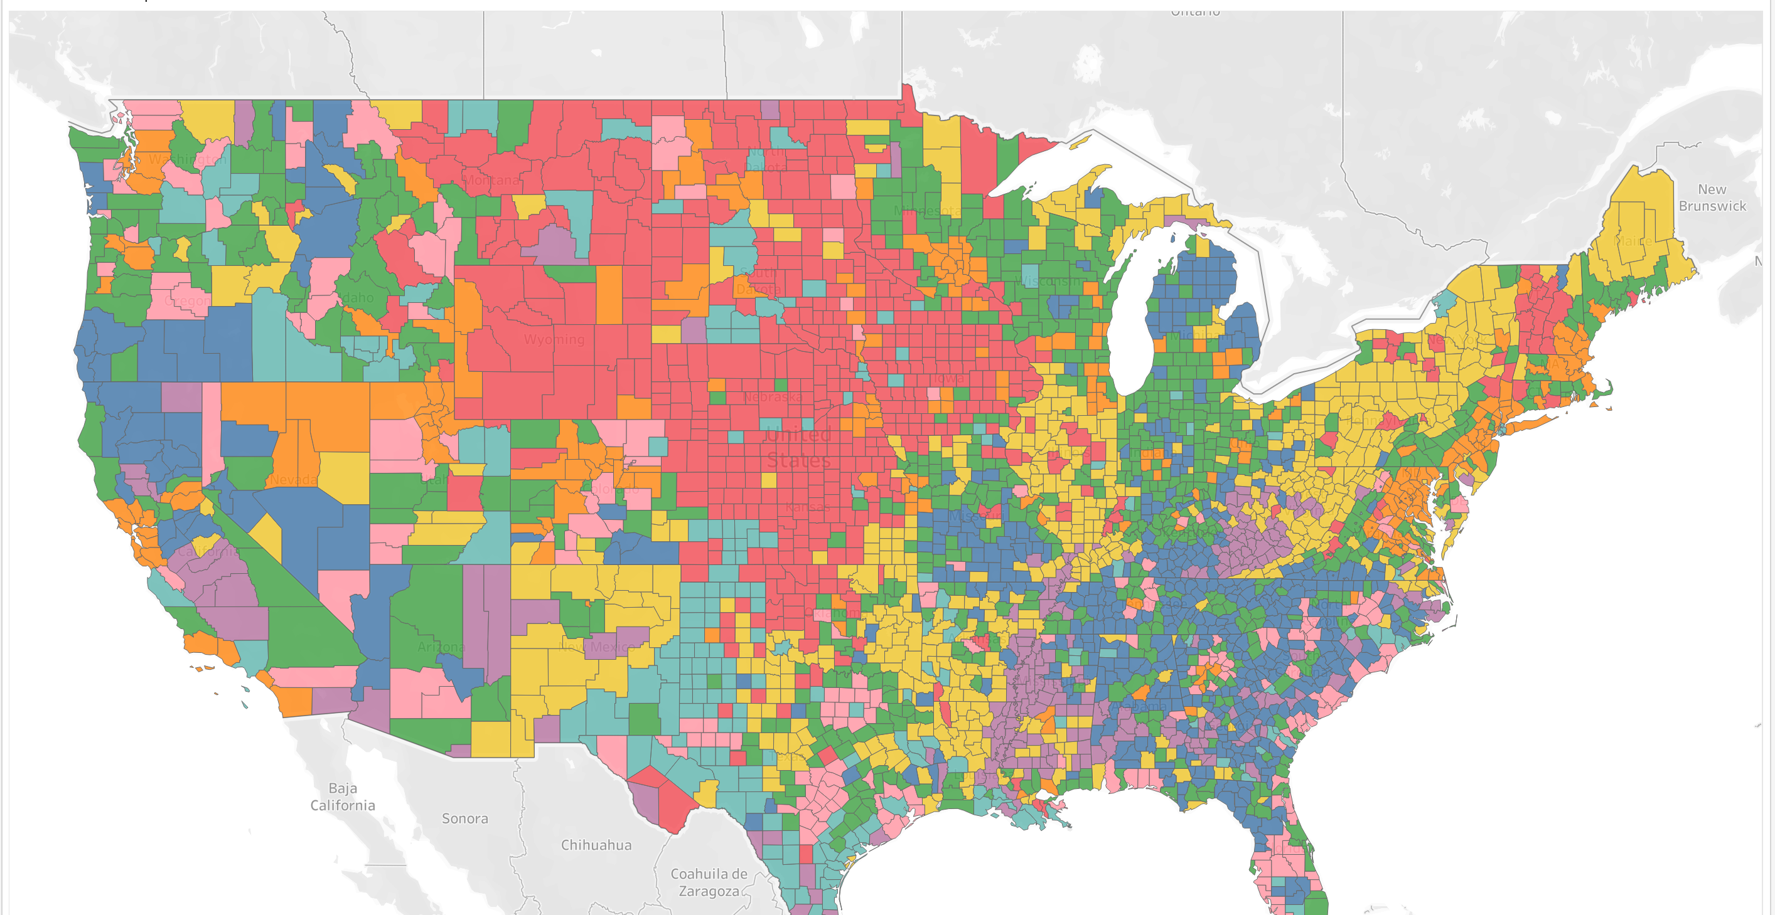
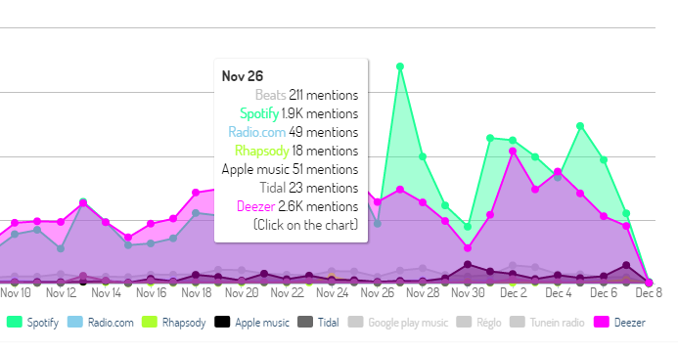
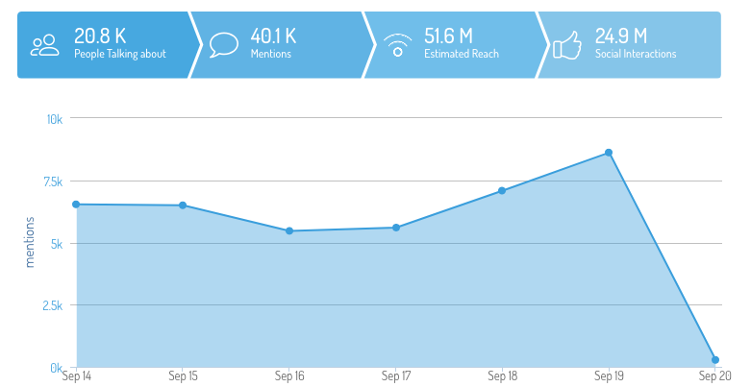
Preferences by Group
Age bands and city clusters
Gender and language
Device type and new vs returning
Notes:
Grouping data by demographics helps uncover who listens, when, and how. Segmenting by age, city, gender, and device type shows how preferences shift across audiences. Highlighting top songs for each group and tracking repeat versus new listeners reveals deeper engagement patterns and helps tailor marketing or playlist recommendations.

Slide 10
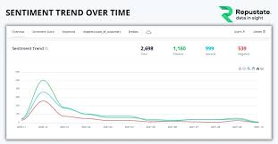
Sentiment and Trends
Positive, neutral, negative share of posts
Peaks during events and seasons
Lift after creator mentions
Notes:
Sentiment analysis helps track how people feel about music over time. By scoring posts as positive, neutral, or negative, we can see emotional responses to songs or campaigns. Peaks often align with seasonal events or creator mentions, revealing moments that drive engagement. Time-based charts make it easy to spot these shifts and plan future promotions around audience sentiment.

Slide 11

Data Collection and Integration
Platform APIs for mentions and tags
Web and app analytics for behavior
Consent capture and clear opt out
Automated pipelines for updates
Notes:
Data collection depends on reliable connections and ethical handling. Use platform APIs to gather mentions, tags, and engagement data, while combining it with site and app analytics for deeper insights. Always capture consent, make opting out simple, and store user choices transparently. Automating data pulls on a schedule keeps dashboards fresh and reporting consistent without adding manual work.

Slide 12




Tools for the Work
Looker Studio for quick dashboards
Tableau or Power BI for deep dives
Hootsuite or Brandwatch for listening
Python or R for custom charts
Notes:
Each tool plays a different role in turning data into insight. Looker Studio helps create quick, shareable dashboards for snapshots. Tableau and Power BI offer deeper analysis with interactive filtering and trend discovery. Hootsuite and Brandwatch gather real-time mentions and engagement across platforms, while Python or R allow full customization for visuals or statistical modeling. Together, these tools make analytics flexible, scalable, and easy to share.

Slide 13

Legal and Ethical Guardrails
Consent for cookies and tracking
Data minimization
Encrypt in transit and at rest
Follow regional privacy rules
Notes:
Ethical analytics means respecting privacy and protecting user trust. Always collect only the data that’s necessary, and make sure users clearly understand what’s being tracked. Encrypt information both during transfer and storage, and comply with regional privacy laws like GDPR. Transparency and minimal data use keep analytics secure and trustworthy.

Slide 14
Notes:
Paradigm Music has the tools and the data to turn user activity into meaningful insight. Social media analytics and visualization make it possible to see how people connect with songs, playlists, and creators in real time. By applying the right KPIs and dashboards, the team can move from raw numbers to clear actions that grow engagement and revenue.

